Slide 1
Ch3 Data Warehouse
Dr. Bernard Chen Ph.D.
University of Central Arkansas
Fall 2010

Slide 2
Knowledge Discovery (KDD) Process
Knowledge
Pattern Evaluation
  Data mining—core of knowledge discovery process
Data Mining
Task-relevant Data
Data Warehouse
Selection
Data Cleaning
Data Integration
Databases

Slide 3
Outline
What is Data Warehouse?
Data Warehouse: A multidimensional data model
Data Warehouse Architecture

Slide 4
What is Data Warehouse?
Loosely speaking, a data warehouse refers to a database that is maintained separately from an organization’s operational database
Officially speaking:
“A data warehouse is a subject-oriented, integrated, time-variant, and nonvolatile collection of data in support of management’s decision-making process.”—William. H. Inmon

Slide 5
Data Warehouse—Subject-Oriented
Organized around major subjects, such as customer, product, sales
Focusing on the modeling and analysis of data for decision makers, not on daily operations or transaction processing
Provide a simple and concise view around particular subject issues by excluding data that are not useful in the decision support process

Slide 6
Data Warehouse—Integrated
Constructed by integrating multiple, heterogeneous data sources
  relational databases, flat files, on-line transaction records
Data cleaning and data integration techniques are applied.
  Ensure consistency in naming conventions, encoding structures, attribute measures, etc. among different data sources
  When data is moved to the warehouse, it is converted.

Slide 7
Data Warehouse—Time Variant
The time horizon for the data warehouse is significantly longer than that of operational systems
  Operational database: current value data
  Data warehouse data: provide information from a historical perspective (e.g., past 5-10 years)

Slide 8
Data Warehouse—Nonvolatile
A physically separate store of data transformed from the operational environment
Operational update of data does not occur in the data warehouse environment
  Does not require transaction processing, recovery, and concurrency control mechanisms
  Requires only two operations in data accessing:
    initial loading of data and access of data

Slide 9
What is Data Warehouse?
In sum, data warehouse is a semantically consistent data store that serves as a physical implementation of a decision support data model and stores the information on which an enterprise needs to make strategic decisioins

Slide 10
Data Warehouse vs. Heterogeneous DBMS
Traditional heterogeneous DB integration: A query driven approach
  Build wrappers/mediators on top of heterogeneous databases
Data warehouse: update-driven, high performance
  Information from heterogeneous sources is integrated in advance and stored in warehouses for direct query and analysis

Slide 11
Data Warehouse vs. Operational DBMS
OLTP (on-line transaction (query) processing)
  Major task of traditional relational DBMS
  Day-to-day operations: purchasing, inventory, banking, manufacturing, payroll, registration, accounting, etc.
OLAP (on-line analytical processing)
  Major task of data warehouse system
  Data analysis and decision making

Slide 12
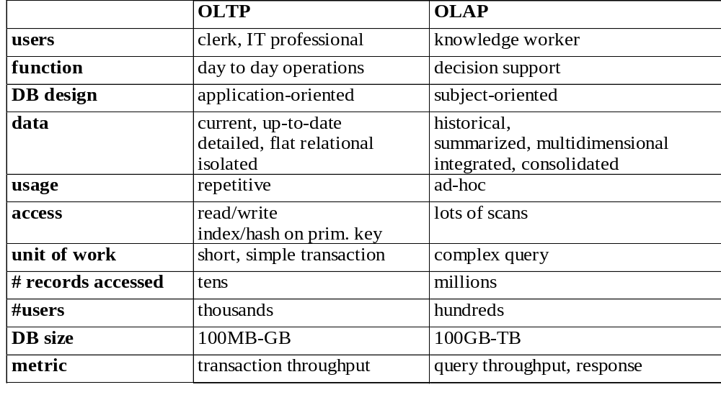
Data Warehouse vs. Operational DBMS

Slide 13
Why Separate Data Warehouse?
Question: why not perform on-line analytical processing directly on such database instead of spending additional time and recourses to construct a separate data warehouse?
High performance for both systems
  DBMS— tuned for OLTP: access methods, indexing, concurrency control, recovery
  Warehouse—tuned for OLAP: complex OLAP queries, multidimensional view, consolidation

Slide 14
Outline
What is Data Warehouse?
Data Warehouse: A multidimensional data model
Data Warehouse Architecture

Slide 15
A multi-dimensional data model
A data warehouse is based on a multidimensional data model which views data in the form of a data cube

Slide 16
Data cube
A data cube, such as sales, allows data to be modeled and viewed in multiple dimensions
Suppose ALLELETRONICS create a sales data warehouse with respect to dimensions
  Time
  Item
  Location

Slide 17
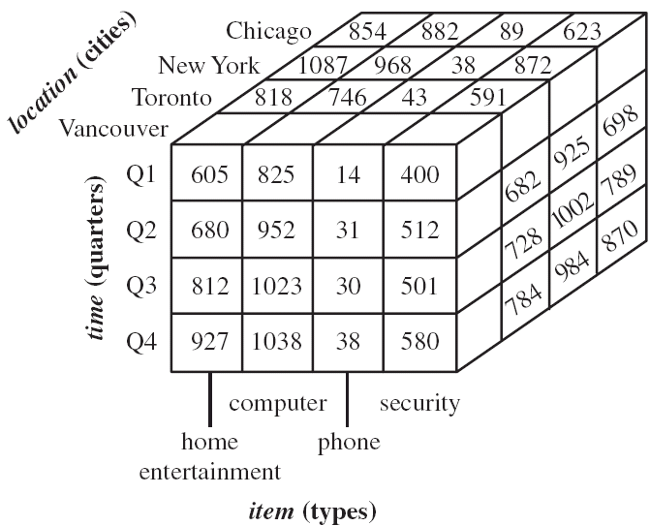
3D Data cube Example

Slide 18
Data cube
A data cube, such as sales, allows data to be modeled and viewed in multiple dimensions
Suppose ALLELETRONICS create a sales data warehouse with respect to dimensions
  Time
  Item
  Location
  Supplier

Slide 19
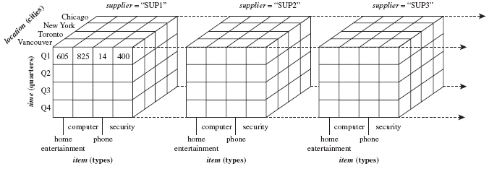
4D Data cube Example

Slide 20
Practice Question
What is a 5D cube looks like?

Slide 21
Conceptual Modeling of Data Warehouses
The most popular data model for a data warehouse is a multi-dimensional model
Such a model can exist in the form of:
  Star schema
  Snowflake schema
  Fact constellations

Slide 22
Conceptual Modeling of Data Warehouses
Star schema: A fact table in the middle connected to a set of dimension tables
It contains:
  A large central table (fact table)
  A set of smaller attendant tables (dimension table), one for each dimension

Slide 23
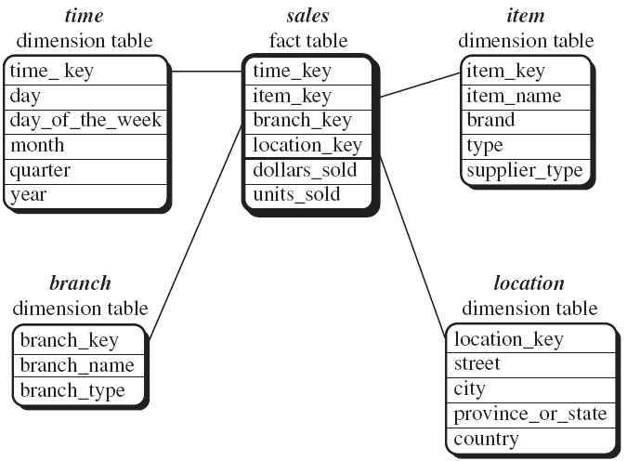
Star schema

Slide 24
Conceptual Modeling of Data Warehouses
Snowflake schema: A refinement of star schema where some dimensional hierarchy is further splitting (normalized) into a set of smaller dimension tables, forming a shape similar to snowflake
However, the snowflake structure can reduce the effectiveness of browsing, since more joins will be needed

Slide 25
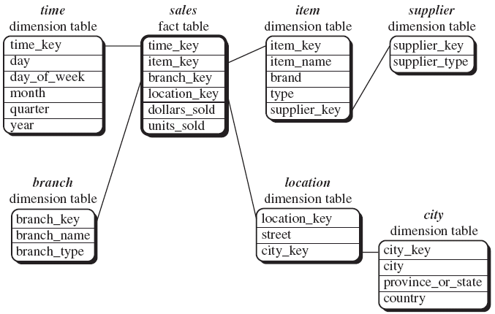
Snowflake schema

Slide 26
Conceptual Modeling of Data Warehouses
Fact constellations: Multiple fact tables share dimension tables, viewed as a collection of stars, therefore called galaxy schema or fact constellation

Slide 27
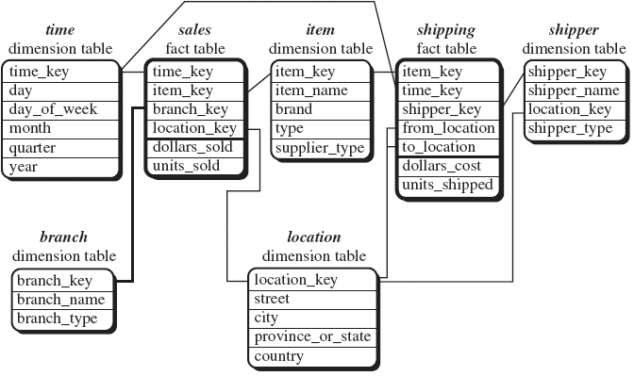
Fact constellations

Slide 28
Concept Hierarchies
A Concept Hierarchy defines a sequence of mappings from a set of low-level concepts to high-level
Consider a concept hierarchy for the dimension “Location”

Slide 29
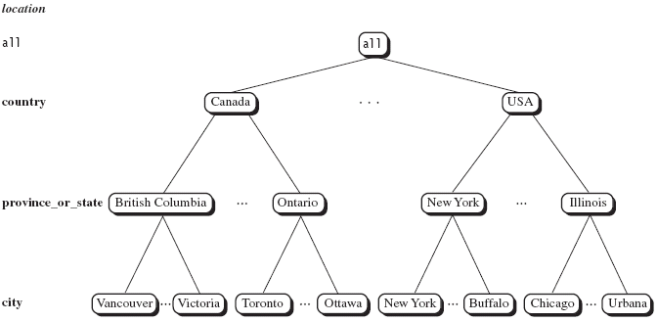
Concept Hierarchies

Slide 30
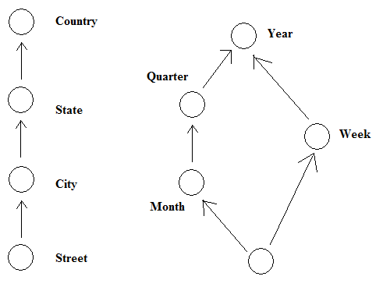
Concept Hierarchies
Many concept hierarchies are implicit within the database system

Slide 31
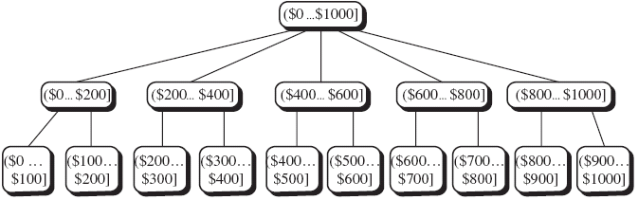
Concept Hierarchies
Concept hierarchies may also be defined by grouping values for a given dimension or attribute, resulting in a set-grouping hierarchy

Slide 32
OLAP Operation
So, how are concept hierarchies useful in OLAP?
In the multidimensional model, data are organized into multiple dimensions,
And each dimension contains multiple levels of abstraction defined by concept hierarchies

Slide 33
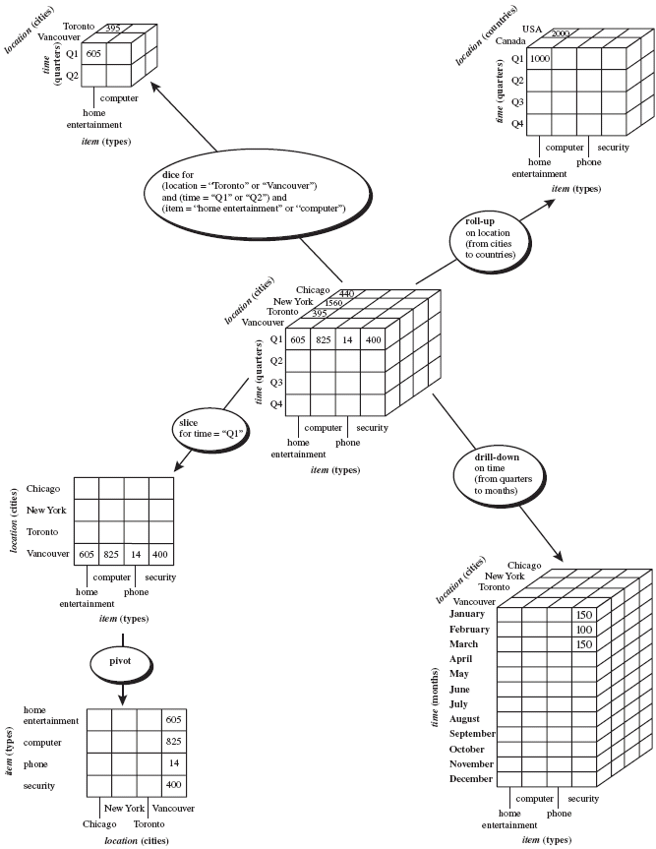

Slide 34
Typical OLAP Operations
Roll up (drill-up): summarize data
  by climbing up hierarchy or by dimension reduction
Drill down (roll down): reverse of roll-up
  from higher level summary to lower level summary or detailed data, or introducing new dimensions

Slide 35
Typical OLAP Operations
Slice and dice: project and select
Pivot (rotate):
  reorient the cube, visualization, 3D to series of 2D planes

Slide 36
A Star-Net Query Model
Customer Orders
Shipping Method
Customer
CONTRACTS
AIR-EXPRESS
ORDER
TRUCK
PRODUCT LINE
Time
Product
ANNUALY
QTRLY
DAILY
PRODUCT ITEM
PRODUCT GROUP
CITY
SALES PERSON
COUNTRY
DISTRICT
REGION
DIVISION
Location
Each circle is called a footprint
Promotion
Organization

Slide 37
Outline
What is Data Warehouse?
Data Warehouse: A multidimensional data model
Data Warehouse Architecture

Slide 38
Design of Data Warehouse
Four views regarding the design of a data warehouse MUST be conserned
  Top-down view
    allows selection of the relevant information necessary for the data warehouse
  Data source view
    exposes the information being captured, stored, and managed by operational systems
  Data warehouse view
    consists of fact tables and dimension tables
  Business query view
    sees the perspectives of data in the warehouse from the view of end-user

Slide 39
Data Warehouse: A Multi-Tiered Architecture
Monitor
&
Integrator
OLAP Server
Other
sources
Metadata
Analysis
Query
Reports
Data mining
Operational
DBs
Extract
Transform
Load
Refresh
Data
Warehouse
Serve
Data Marts
Data Sources
Data Storage
OLAP Engine
Front-End Tools

Slide 40
Three Data Warehouse Models
Enterprise warehouse
  collects all of the information about subjects spanning the entire organization
Data Mart
  a subset of corporate-wide data that is of value to a specific groups of users. Its scope is confined to specific, selected groups, such as marketing data mart
    Independent vs. dependent (directly from warehouse) data mart
Virtual warehouse
  A set of views over operational databases. Only some of the possible summary views may be materialized.

Slide 41
Data Warehouse Development: A Recommended Approach
4
Multi-Tier Data Warehouse
3
Distributed Data Marts
2
Enterprise Data Warehouse
1
Data Mart
Data Mart
Model refinement
Model refinement
Define a high-level corporate data model

Slide 42
Metadata Repository
Meta data is the data defining warehouse objects. It stores:
Description of the structure of the data warehouse
  schema, view, dimensions, hierarchies, derived data defn, data mart locations and contents
Operational meta-data
  data lineage (history of migrated data and transformation path), currency of data (active, archived, or purged), monitoring information (warehouse usage statistics, error reports, audit trails)
The algorithms used for summarization
The mapping from operational environment to the data warehouse
Data related to system performance
  warehouse schema, view and derived data definitions
Business data
  business terms and definitions, ownership of data, charging policies

Slide 43
Efficient Processing OLAP Queries
Determine which operations should be performed on the available cuboids
Determine which materialized cuboid(s) should be selected for OLAP op.

Slide 44
Efficient Processing OLAP Queries
Suppose we define a data cube of the form of
  Day<month<quarter<year
  Item_name<brand<type
  Street<city<province or state<country

Slide 45
Efficient Processing OLAP Queries
Let the query to be processed be on {brand, province_or_state} with the condition “year = 2004”, and there are 4 materialized cuboids available:
    1) {year, item_name, city}
    2) {year, brand, country}
    3) {year, brand, province_or_state}
    4) {item_name, province_or_state} where year = 2004
    Which should be selected to process the query?

Slide 46
Efficient Processing OLAP Queries
Cuboid 1,3,4 can be applied
  Finer granularity data cannot be generated from coarser-granularity data

Slide 47
Data Warehouse Usage
Three kinds of data warehouse applications
  Information processing
    supports querying, basic statistical analysis, and reporting using crosstabs, tables, charts and graphs
  Analytical processing
    multidimensional analysis of data warehouse data
    supports basic OLAP operations, slice-dice, drilling, pivoting

Slide 48
Data Warehouse Usage
  Data mining
    knowledge discovery from hidden patterns
    supports associations, constructing analytical models, performing classification and prediction, and presenting the mining results using visualization tools

